Slide 1
Noise and Heterogeneity in Historical Build Data - An Empirical Study of Travis CI
Keheliya Gallaba,
McGill University
keheliya.gallaba@mail.mcgill.ca
Christian Macho
University of Klagenfurt
christian.macho@aau.at
Martin Pinzger
University of Klagenfurt
martin.pinzger@aau.at
Shane McIntosh
McGill University
shane.mcintosh@mcgill.ca
Presented by:
Kazi Amit Hasan
School of Computing, Queen’s University

Slide 2
Build outcome data is used to solve software engineering research problems
For measuring the build breakage rate
For understanding and predicting build breakage
For communicating the current build status

Slide 3
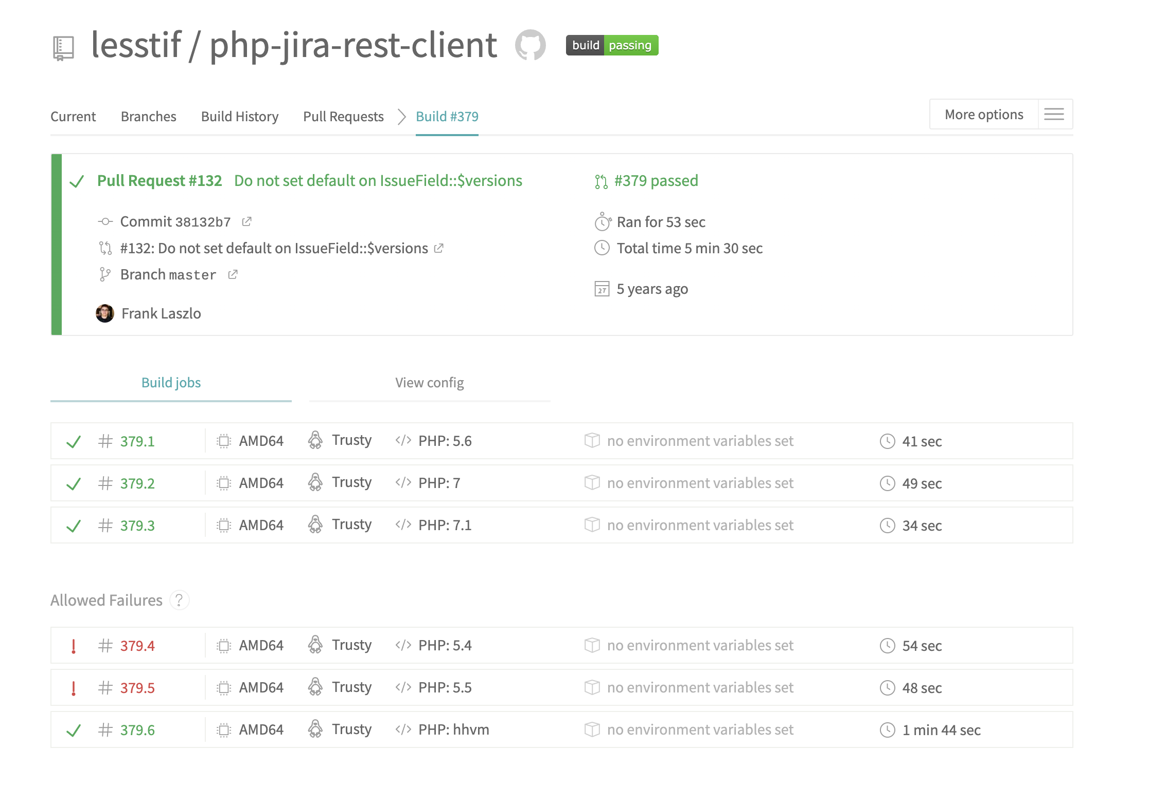
Can the off-the-shelf historical CI build data be trusted?
Final build outcome does not always tell the complete story.
allow_failure enables experimentation with support for a new platform.
The zdavatz/spreadsheet project has had the allow_failure feature enabled for the entire lifetime of the project!

Slide 4
Are build outcomes free of noise?
Are build outcomes homogeneous?

Slide 5
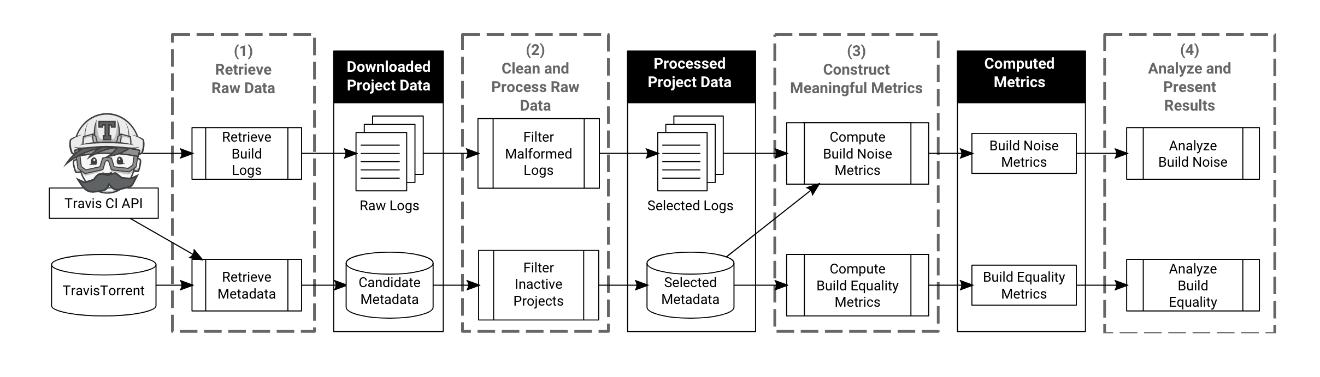
Studied 680,209 Travis CI builds spanning 1,276 open source projects
An overview of the approach followed for data analysis

Slide 6
Actively Ignored
Are build outcomes free of noise?
Passively Ignored
Stale

Slide 7

We look for passing builds with actively ignored failures
To prevent failing jobs in experimental areas, Travis CI users can set the allow_failure property when testing against versions or configurations that developers are not ready to officially support.
Select passing builds
Select builds with failing jobs
Check if the allow_failure property is enabled for the failing jobs in .travis.yml
680,209 Builds
496,204 Builds
59,904
Builds
How often breakages are actively ignored in corpus?

Slide 8
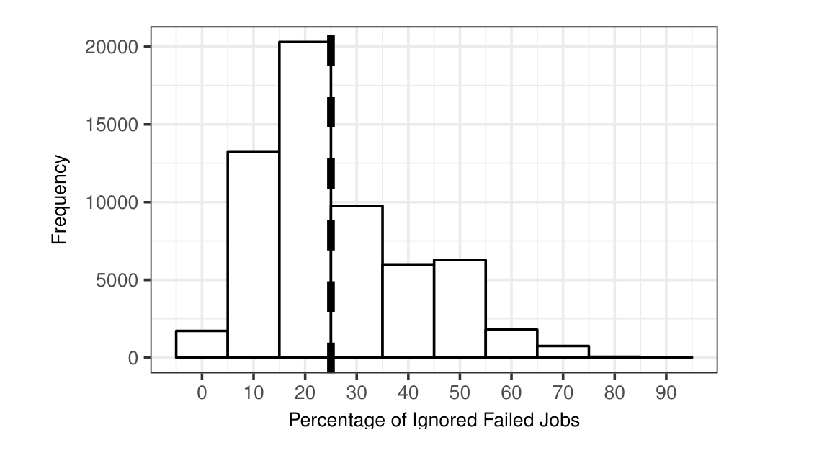
Passing build outcomes do not always indicate that the build was entirely clean
12% of passing builds have an actively
ignored failure.
In an extreme case, 87% of the jobs
were actively ignored.

Slide 9
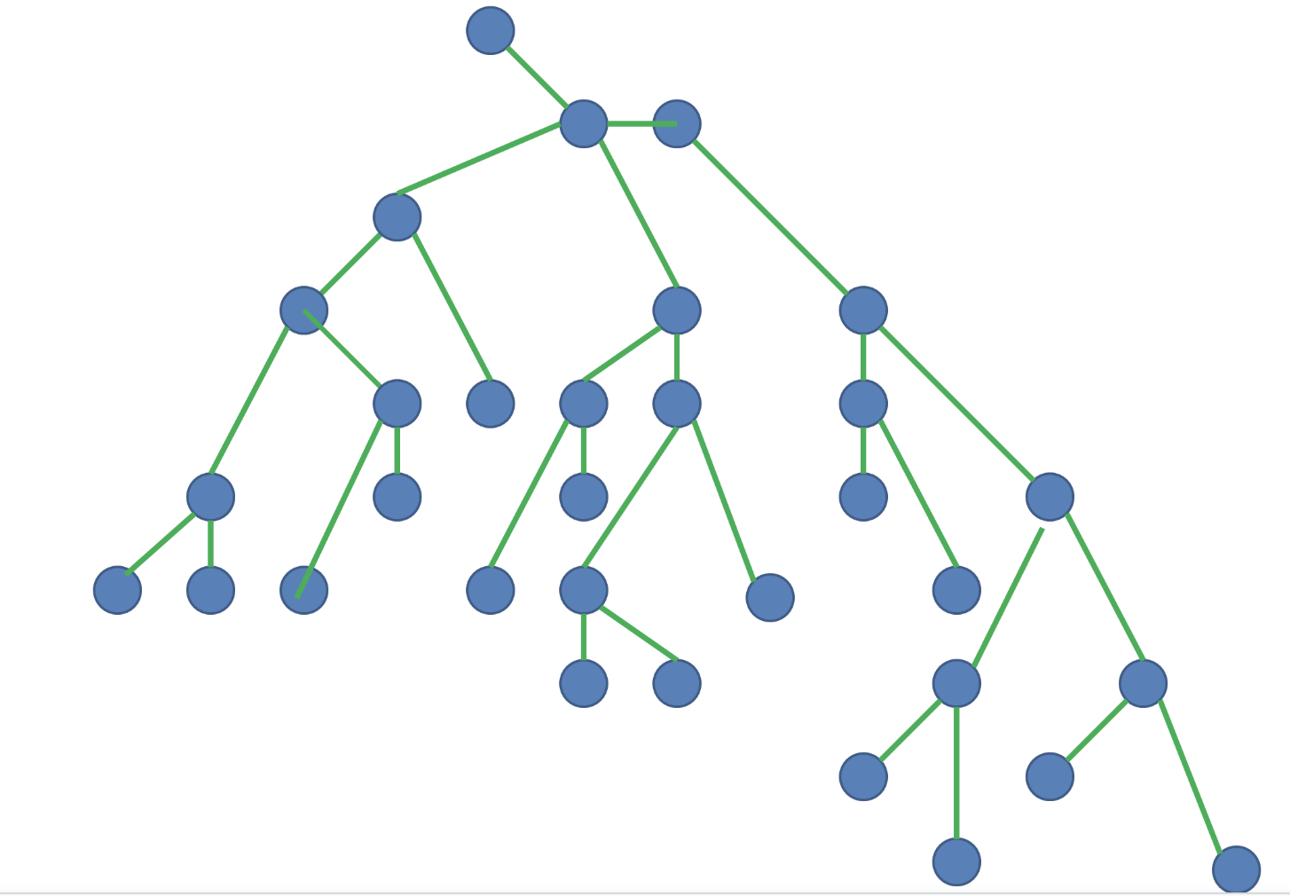
Passively ignored breakages may introduce noise when all breakages are assumed to be distracting
Long breakage sequences may mean developers passively ignored failures by not immediately fixing them
Graph construction using version control data
Build
Filtering
Graph Analysis
680,209 Builds
610,550 Builds
how often breakages are passively ignored?

Slide 10
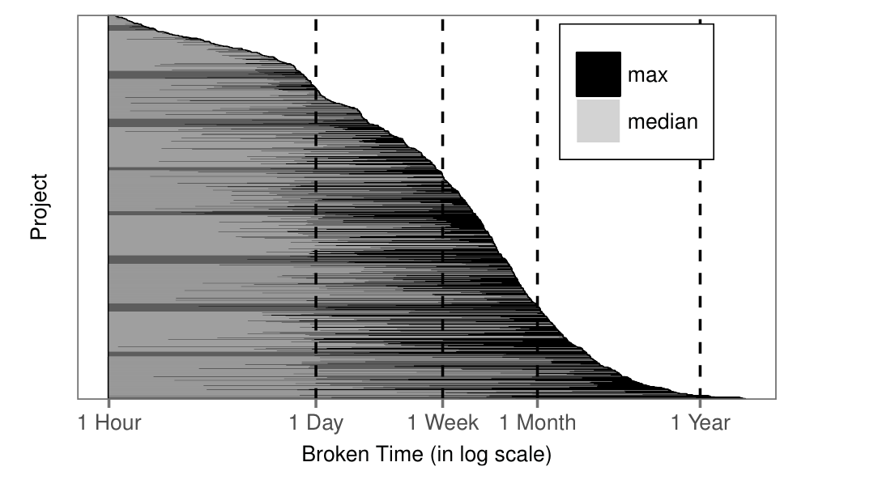
In some cases, builds can remain broken for 423 days
Overall median length of the failure sequence is five commits.
In 83% of branches from broken builds, the breakage persists. These breakages persist for up to 485 commits.

Slide 11
One of the reasons for ignoring a build breakage: Staleness
- Developers may become desensitized to stale breakage
- If the project has encountered a given breakage in the past, then it's a stale breakage.

Slide 12
Measured staleness in Maven build breakages
Investigated how many times developers come across the same breakage repeatedly
Maven Build Log
Build fails due to the same reason as a prior failure?
Failure details are equal to a prior failure?
Stale Breakage
YES
YES
NO
NO
Not Stale Breakage

Slide 13
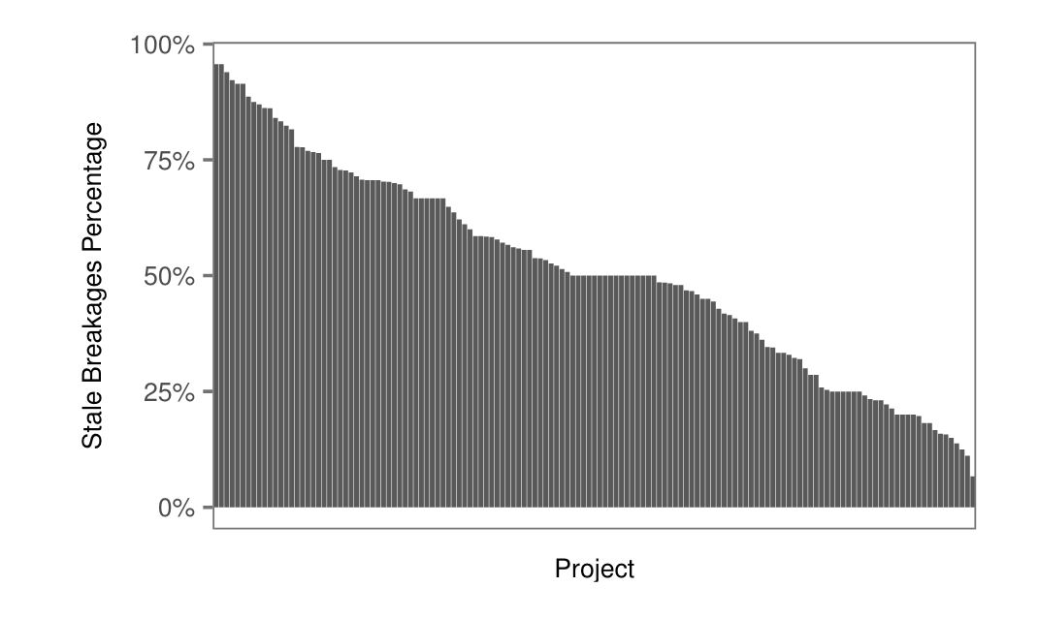
Two of every three build breakages are stale
67% of the breakages (6,889 out of 10,816) that we analyze are stale breakages
On the project level, staleness of breakages ranges from 7% to 96% with a median of 50%.

Slide 14
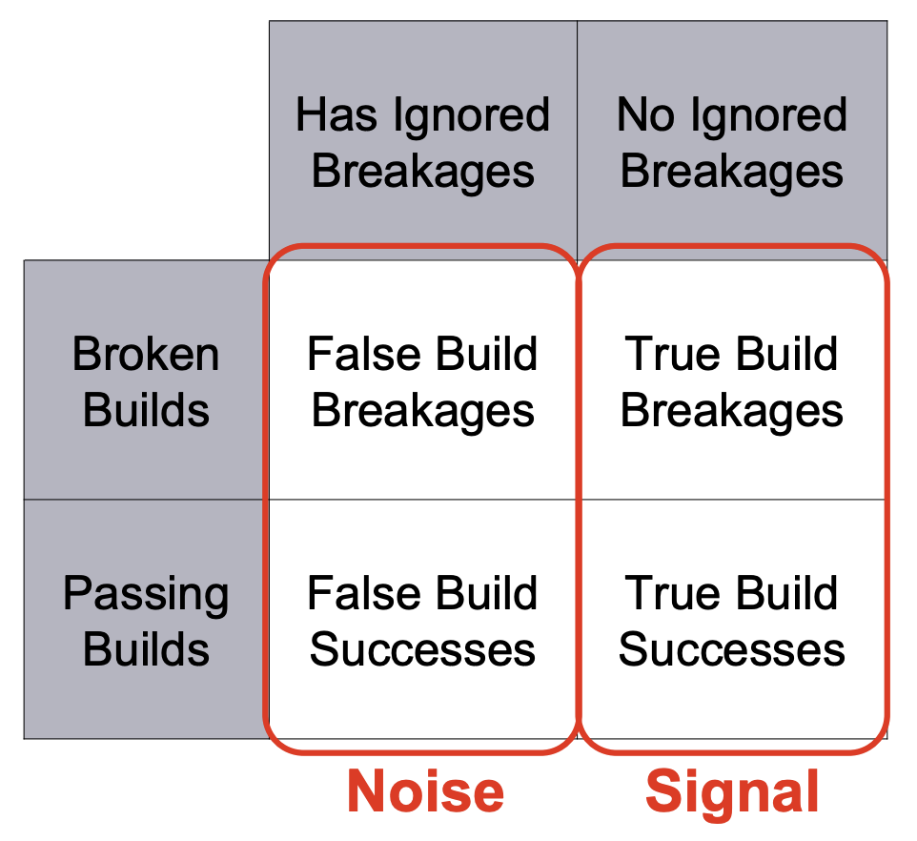
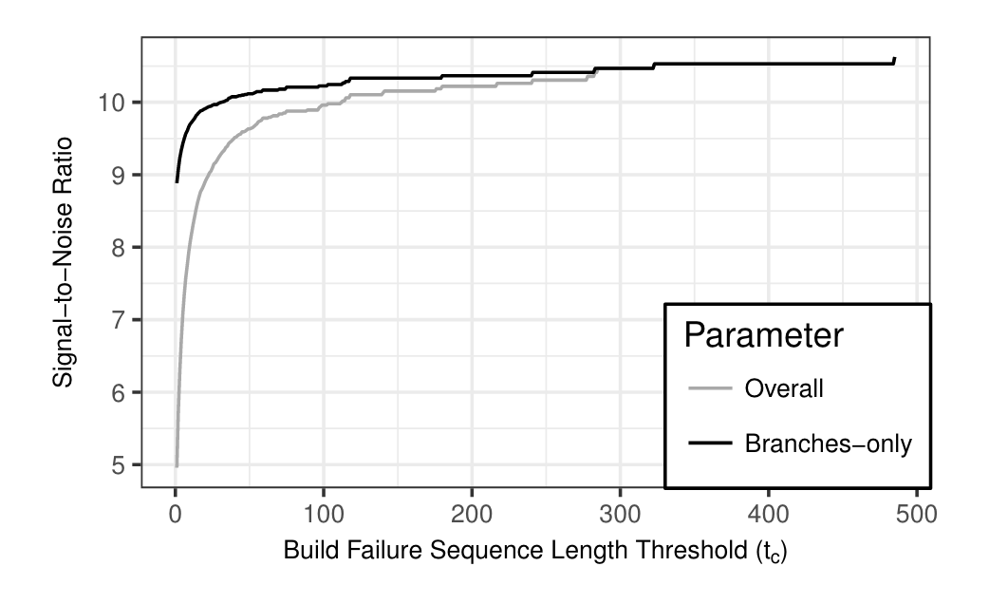
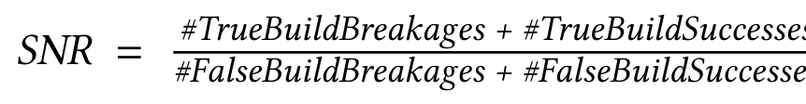
Proposed Signal-To-Noise Ratio to quantify the proportion of noise
One in every 7 to 11 builds (9%-14%) is incorrectly labelled

Slide 15
Are build outcomes free of noise?
Passing build outcomes do not always indicate that the build was entirely clean
Build breakages can persist for up to 485 commits (423 days)
67% of build breakages we analyze are stale
9%-14% of builds are incorrectly labelled
Are build outcomes homogeneous?

Slide 16
Matrix breakage purity
Are build outcomes homogeneous?
Classify broken builds by the root cause
Classify revisions by contributor type

Slide 17
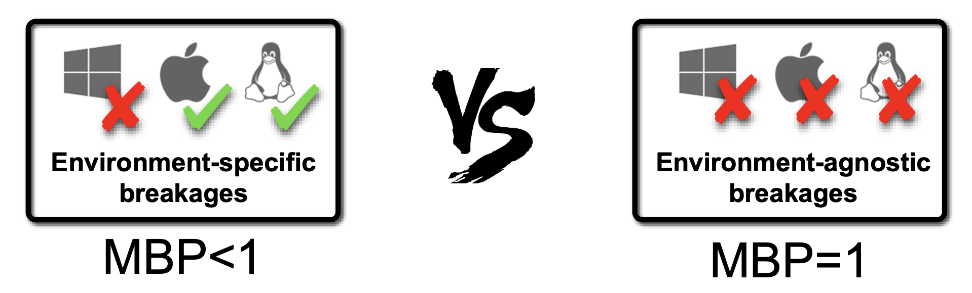
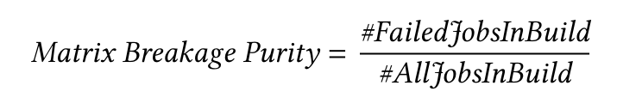
Computing the Matrix Breakage Purity
Computed the Matrix Breakage Purity for all builds in our dataset
Labeled all builds that have a MBR below one as impure build breakages.

Slide 18
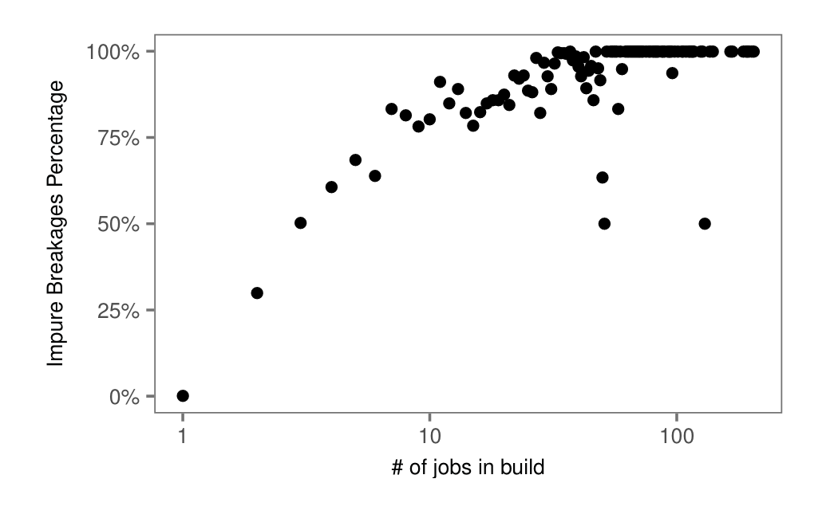
Environment-specific breakage is commonplace
Builds with a greater number of jobs are more likely to suffer from impure build breakages.

Slide 19
Builds can break for various reasons
Extend Maven Log Analyzer to parse and classify broken Maven build logs by type
Dependency Resolution Failure
Test Failure
Compilation Failure
Deployment Failure

Slide 20
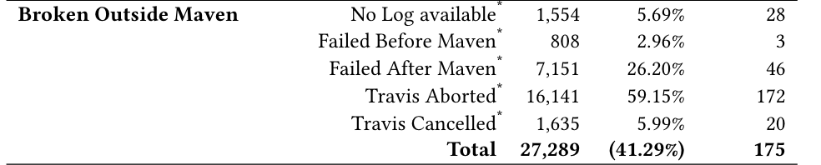
Tool-specific breakage is rare
41% of the broken builds in corpus failed due to problems outside of the execution of the main build tool.
Since tool specific breakage is rare, future automatic breakage recovery techniques should tackle issues in the CI scripts themselves

Slide 21
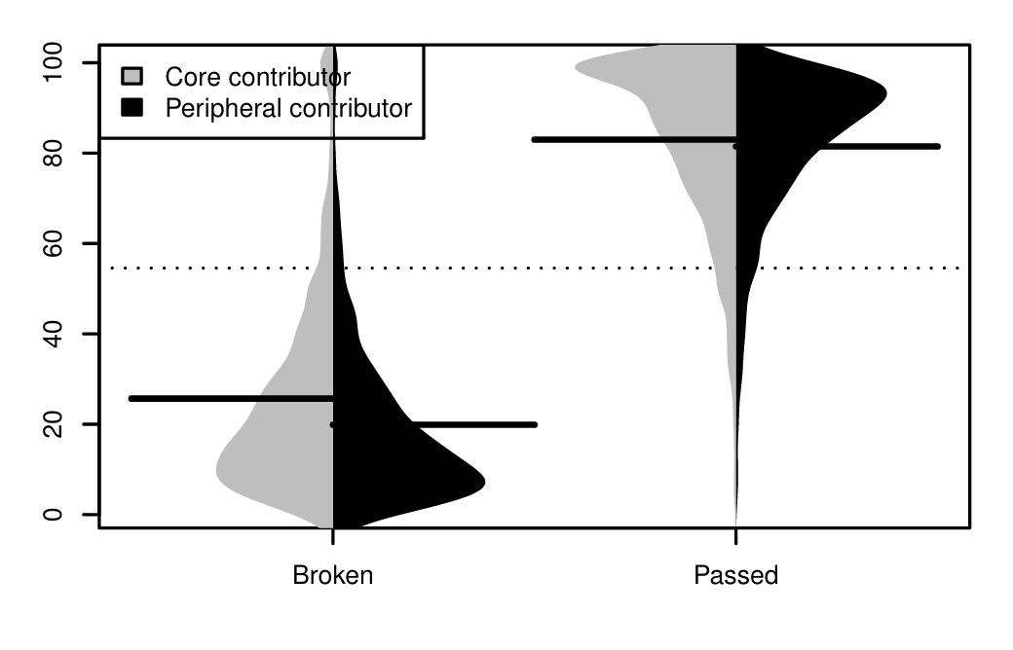
Both core and peripheral contributors trigger builds
Builds triggered by core team members are break significantly more often!
Due to having more experience, core team members in the development teams are assigned to complex tasks, which may explain why breakage rates tend to be a little higher.

Slide 22
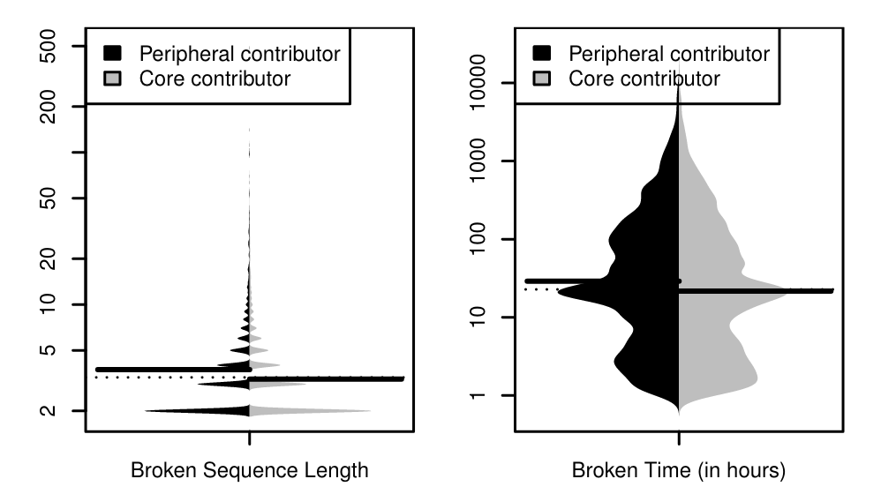
Core vs Peripheral
Chains of consecutive breakages caused by peripheral contributors tend to be longer.
Build breakages caused by peripheral contributors take more time to repair.
Broken builds that are caused by core contributors tend to be fixed sooner.

Slide 23
Are build outcomes free of noise?
Are build outcomes homogenous?
Passing build outcomes do not always indicate that the build was entirely clean
Build breakages can persist for up to 485 commits (423 days)
67% of build breakages we analyze are stale
9%-14% of builds are incorrectly labelled
Environment-specific breakage is commonplace
Tool-specific breakage is rare
Future automatic breakage recovery techniques should tackle issues in the CI scripts

Slide 24
Broader implications of the observations for researchers and tool builders
For Research Community
For Tool Builders
Build outcome noise should be filtered out before subsequent analyses.
Heterogeneity of builds should be considered when training build outcome prediction models
Automatic breakage recovery should look beyond tool-specific insight
Richer information should be included in build outcome reports and dashboards

Slide 25
